Slide 1


HR ATTRITION DATA ANALYSIS
HR ATTRITION DATA ANALYSIS
A BRIEF INTRODUCTION TO THE HR ATTRITION DATA ANALAYSIS WHICH HELPS TO INCREASE THE GROWTH OF COMPANAY PROFITS AND LOOK AFTER THE WELLNESS OF EMPLOYEES

Slide 2




HR ATTRITION DASHBOARD(INTRODUCTION)
A Demographic report
Summarizes employees statistics , including age groups, gender , distance from home and martial status , proving insights into workforce diversity and commuting patterns for informed decision –making.
A Turnover analysis report consolidates employee data, featuring attrition by job level overtime performance ratings , monthly income and attrition increase levels , offering critical insights for effective HR strategies and decision –making.
The Turnover Analysis I report
Provides insights into employee attrition , including departures b departments . Job roles affected business ,travel impact, and total years in the current role , aiding in workforce management and retention strategies.
A Employee Wellness report consolidates employee data . Featuring attrition by job level overtime performance ratings , monthly income and attrition increase levels offering critical insights for effective HR strategies and decision – making.

Slide 3
Tasks to perform -
Data Cleaning:
• Deleting redundant columns.
• Renaming the columns.
• Dropping duplicates.
• Cleaning individual columns.
• Remove the NaN values from the dataset.
• Check for some more Transformations.
Data Visualization:
• Plot a correlation map for all numeric variable Overtime
• Marital Status
• Job Role
• Gender
• Education Field
• Department
• Business Travel
• Relation between Overtime and Age
• Total Working Year
• Education Level
• Number of Companies Worked
• Distance from Home

Slide 4
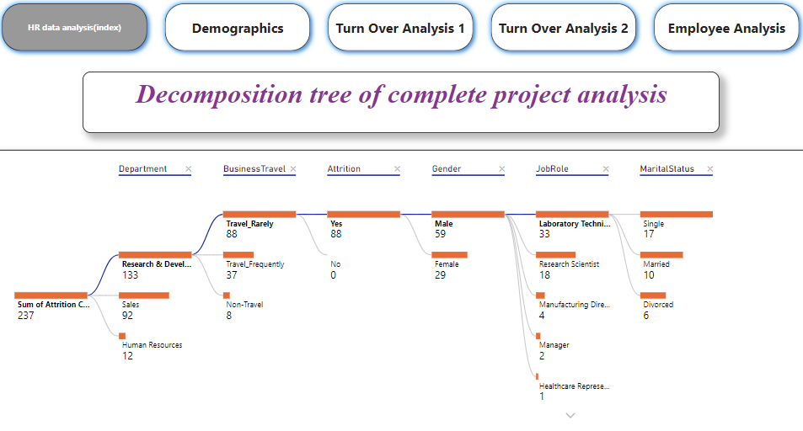

Slide 5
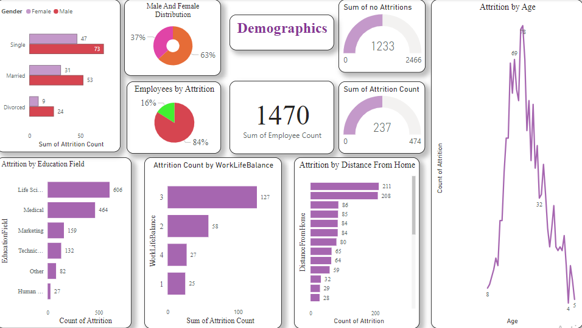





Slide 6
Key Insights
Analysis done on the employees are nearly 1470
Total employees who are not interested are 1233
Total employees who are interested are 237
Male and Female distribution in company is nearly 63 percent and 37 percentage.
Maximum age for attribution is 78 years
Life science and medical field has more attribution than any other field
Around 127 members give average in work satisfaction
Distance from home is also a key factor in this analysis which give them a mental stability and accuracy in mind
Unmarried male are more compared to married and divorced men.

Slide 7
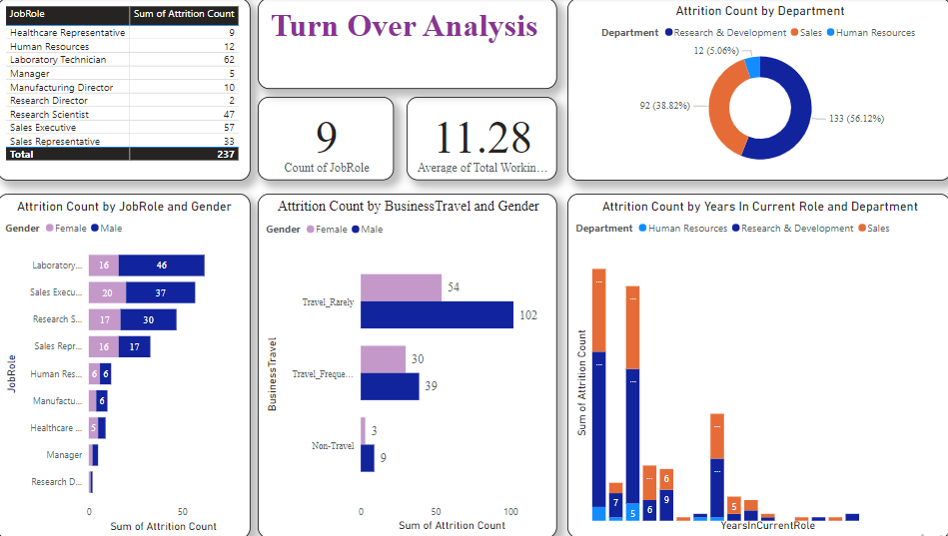


Slide 8
Key Insights
Turn over analysis plays a key in maintaining people mental health and dependencies
Total job roles in the company is 9 .
Average working hours in the company is 11.28 hours
Research ,sales and human resource plays a key in the company development , research and development is most vital taking around 56.12% in attributions
Laboratory department has more difference in gender nearly 20 members.
Males travel rarely are nearly 102 and female travel rarely are nearly half of them around 54 people

Slide 9
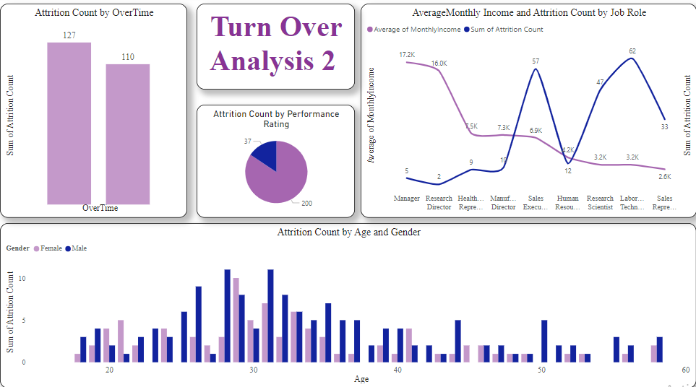


Slide 10
Key Insights
Attrition rate who are doing over time male and female is around 127 and 110.
Average monthly income of manager is 17,500 and minimum monthly average job is sales representative with 2,600
Attrition count of Labour technician is maximum with 62 in number and manager gets minimum attribution count of only 5 members.
Performance rating of males will be 200 and other is 37.
Male age at 31 and 28 has maximum attribution count , female has maximum count at 29.

Slide 11
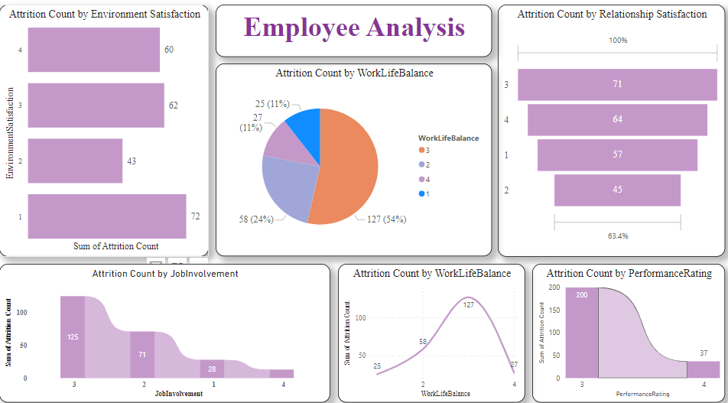



Slide 12
Key Insights
Employees wellness plays a key role in company development.
Employees are not satisfied with the job environment due this people has given 72 votes
as bad in condition .
Job involvement is fine with the people around as the condition is good and number of votes are 125.
Attrition count given for work life balance around 127.
Attrition count for performance rating is around 200 at good condition .

Slide 13


